Slide 1
Analysis of Chicago Neighborhoods for Potential Food Truck Locations
Maryna Bort

Slide 2
Introduction/Business Problem
Client: Food Truck Business “Hot Potatoez”
Problem: expanding business to Chicago, what locations would be best?
Potential Solution: locations that are not crowded with a lot of restaurants or fast food chains. Preferably parks, and other outdoor public venues.

Slide 3
Data
Data consists of 2 pieces:
List of Chicago neighborhoods, their longitude, latitude. Acquired through Data.Opendatasoft.com
Most common venues per neighborhood acquired through FourSquare.com
Combined data is analysed and clustered to find a set of neighborhoods that fit the business the most.

Slide 4
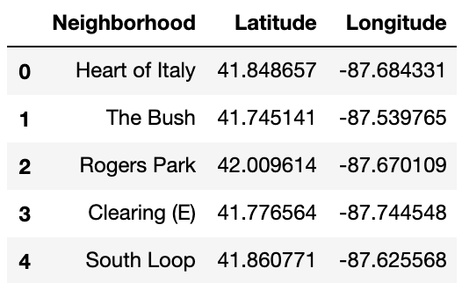
Methodology
Data put into a dataframe with the names of the Chicago neighborhoods and theit coordinates:

Slide 5
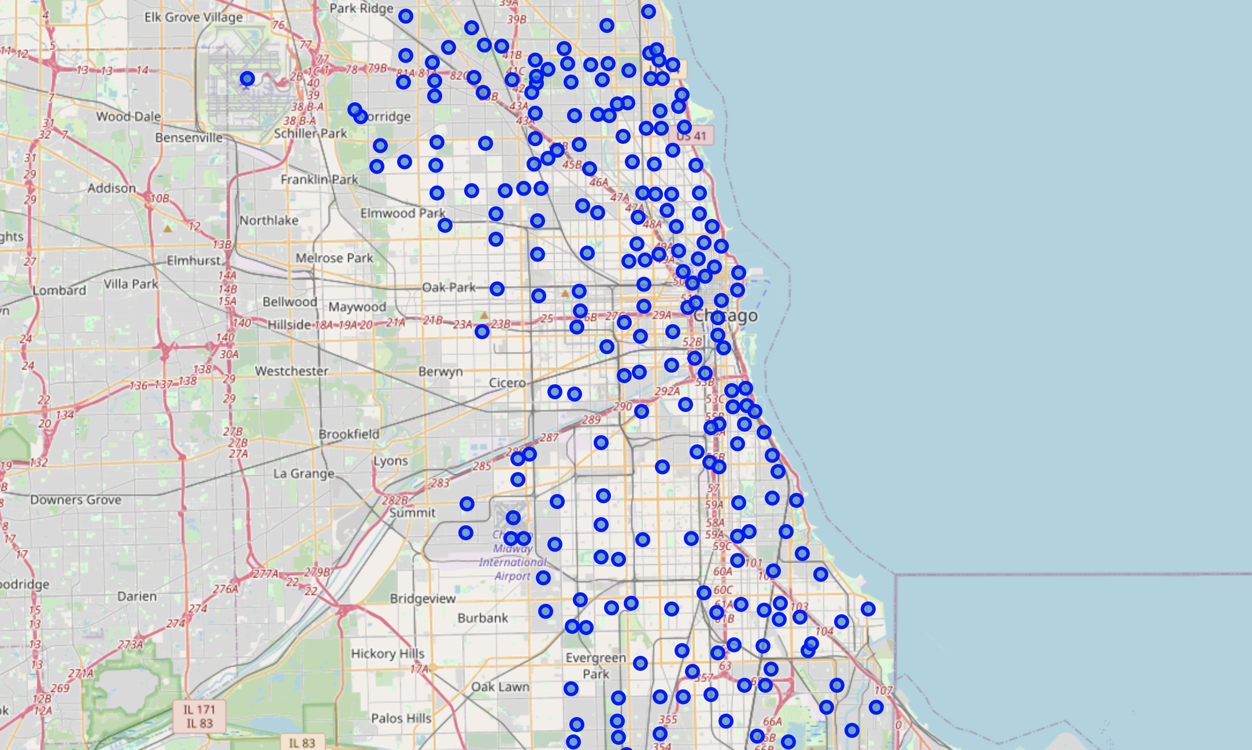
Methodology
Neighborhoods mapped using Geopy:

Slide 6
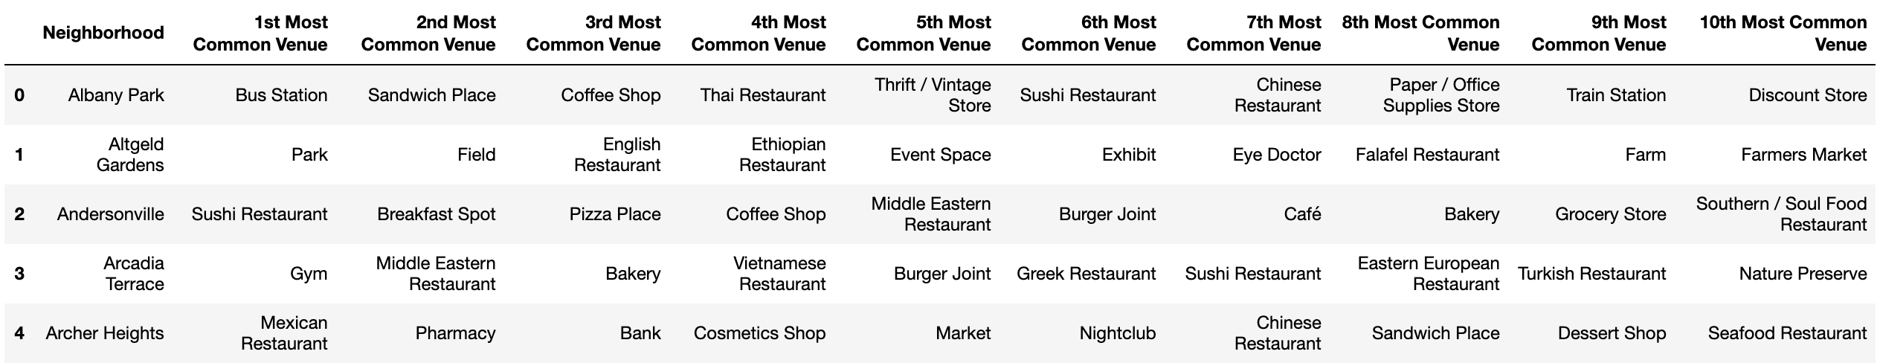
Methodology
Using the FourSquare API retrieve the top 10 most common venues per neighborhood, put results into a dataframe:

Slide 7
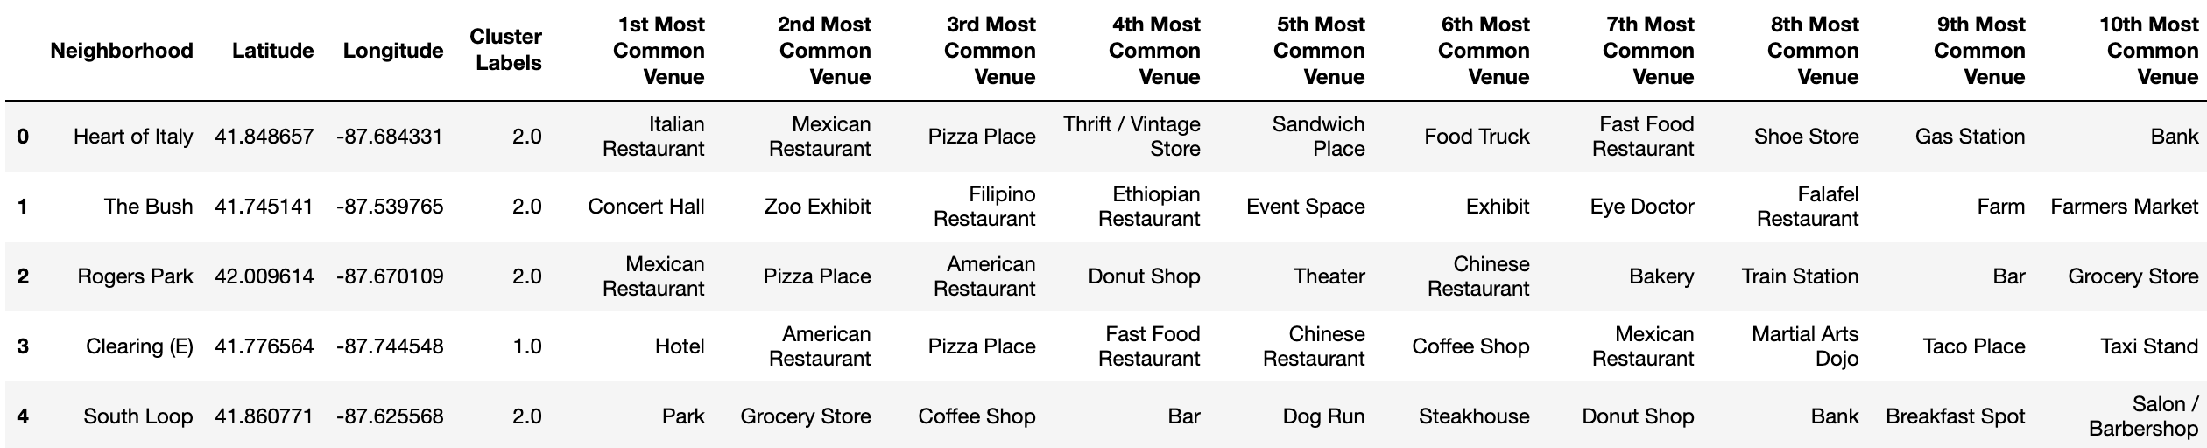
Methodology
Using K-Means, cluster our neighborhoods into 10 clusters based on their most common venues:

Slide 8
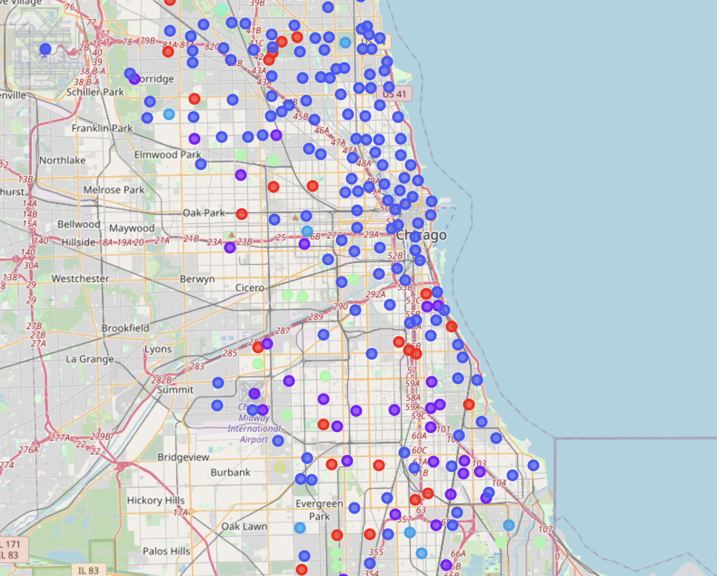
Methodology
Add the resulting clusters to the map of Chicago:

Slide 9
Results and Conclusion
Clusters that fit the best to our business contain the following venues as the most common: parks, soccer fields, pools, beaches, zoo exhibits, farmers markets and bike trails.
Clusters that fit the description:
Cluster #1
Cluster #8

